Slide 1

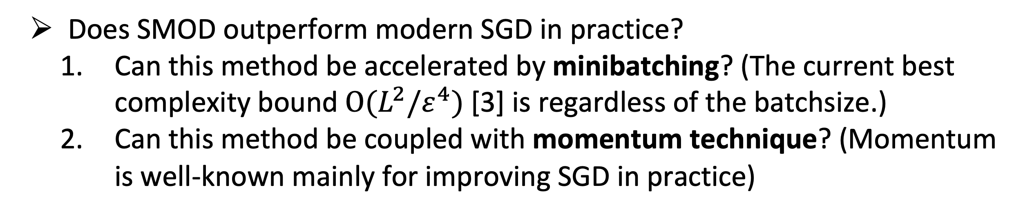
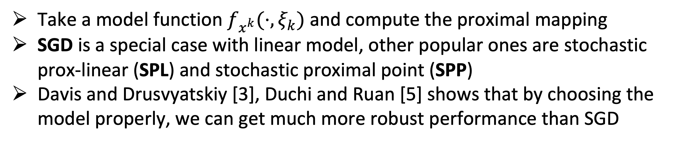
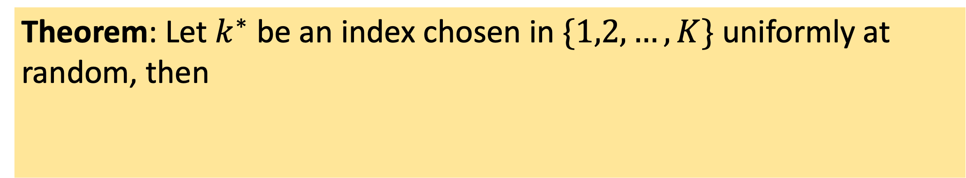
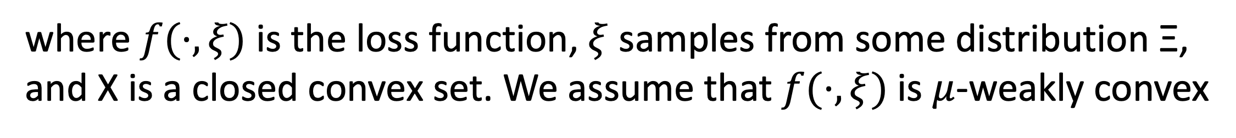
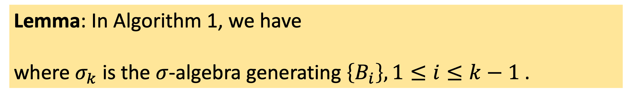

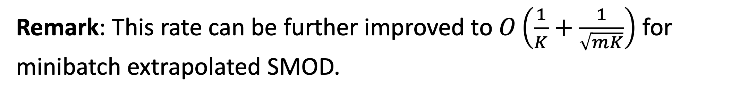
Minibatch and Momentum Model-based Methods for Stochastic Non-smooth Non-convex Optimization
（基于模型的随机优化方法）
AI
+
优化
扫码获取论文
Qi Deng and Wenzhi Gao
Problem of interests
SMOD with minibatches
Convex optimization (appendix)
Both Polyak and Nesterov type momentum are considered
where $f(⋅,ξ)$ is the loss function, $ξ$ samples from some distribution Ξ,
and X is a closed convex set. We assume that $f(⋅,ξ)$is $μ$-weakly convex
Stochastic model-based (SMOD) optimization
Key insight: stability of proximal mapping
Take a model function $f_{x^{k}}(⋅,ξ_{k})$ and compute the proximal mapping
SGD is a special case with linear model, other popular ones are stochastic prox-linear (SPL) and stochastic proximal point (SPP)
Davis and Drusvyatskiy [3], Duchi and Ruan [5] shows that by choosing the model properly, we can get much more robust performance than SGD
Lemma: In Algorithm 1, we have
where $σ_{k}$ is the $σ$-algebra generating $\left\{B_{i}\right\}, 1≤i≤k−1$.
Experiments
Robust phase retrieval
Theorem: Let $k^{∗}$ be an index chosen in $\{1,2,…,K\}$ uniformly at random, then
(See the paper for more details)
Does SMOD outperform modern SGD in practice?
Can this method be accelerated by minibatching? (The current best complexity bound $O(L^{2}/ε^{4})$[3] is regardless of the batchsize.)
Can this method be coupled with momentum technique? (Momentum is well-known mainly for improving SGD in practice)
Remark: To obtain an iterate whose expected gradient norm is than $ε$, the total iteration count is
Our contribution
SMOD with momentum
The first study to show that SMOD enjoys linear speedup by minibatching for non-smooth and non-convex problems
A new extrapolated model-based method by incorporating a Polyak-type momentum term
Improved convergence rates in the convex setting (see appendix)
Theorem: For Algorithm 2, we have
Reference
Qi Deng and Wenzhi Gao. "Minibatch and Momentum Model-based Methods for Stochastic Non-smooth Non-convex Optimization." Accepted to NeurIPS 2021
Remark: This rate can be further improved to $O\left(\frac{1}{K}+\frac{1}{\sqrt{mK}}\right)$ for minibatch extrapolated SMOD.

